Slide 1
One infinite plane (at x = 0) oriented in the yz plane at potential V₀:
General solution
Boundary condition: B must be V₀!
Solution:
Obviously A = -σ/2ε₀

Slide 2
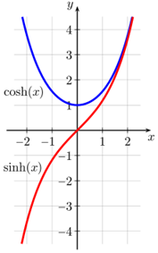
Consider a box. The side oriented in the yz plane at x = 1 is at potential V₀, the parallel one is at x = 0 and grounded. All the other sides are also grounded. Look at the solution along x only.
General solution
How to account for the boundary condition that V = 0 at x = 0?
A = -B, k = 1
sinh(x) shows the desired behavior, A = V₀/2sinh(1)

Slide 3
Consider a box. The two parallel sides in the yz plane are held at potential V₀, one is at x = -1 is other one is at x = 1. All the other sides are grounded. Look at the solution along x only.
General solution
How to account for the boundary condition that V = 0 at x = 0?
A = B, k = 1
cosh(x) shows the desired behavior, A = V₀/2cosh(1)

